Slide 1
Research data sharing and management
Rosie Higman (@RosieHLib)
Office of Scholarly Communication
5th December 2016

Slide 2
“Research data are the evidence that underpins the answer to the research question, and can be used to validate findings regardless of its form (e.g. print, digital, or physical).”
HEFCE Concordat on Open Research Data: http://www.rcuk.ac.uk/documents/documents/concordatonopenresearchdata-pdf/

Slide 3
Why is it important to share research?

Slide 4
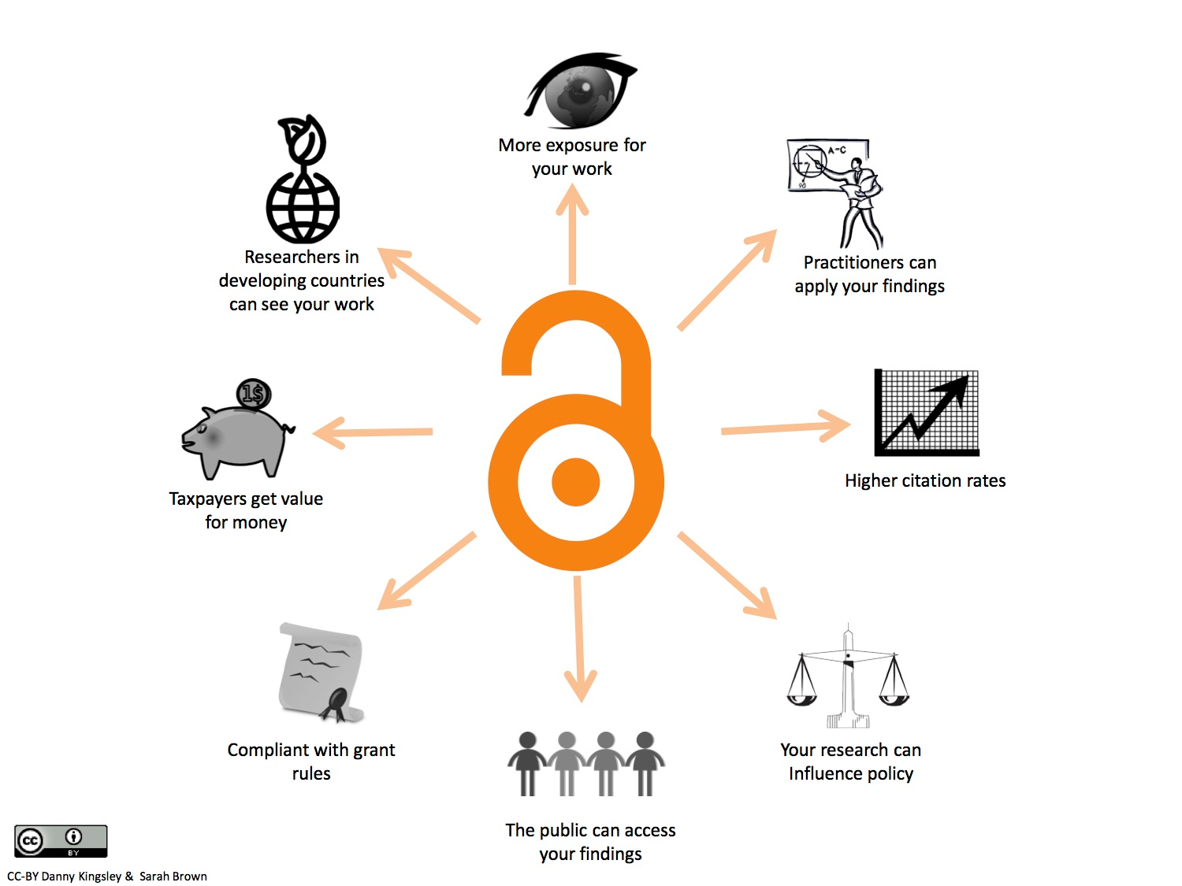
Sharing your research is A Good Thing
Notes:
OA slides here

Slide 5
Some other very important reasons to share

Slide 6
Open Research is fundamental to being an academic
Research relies on the principle that we share our findings
Ideas and results need to be shared to move human knowledge forward

Slide 7
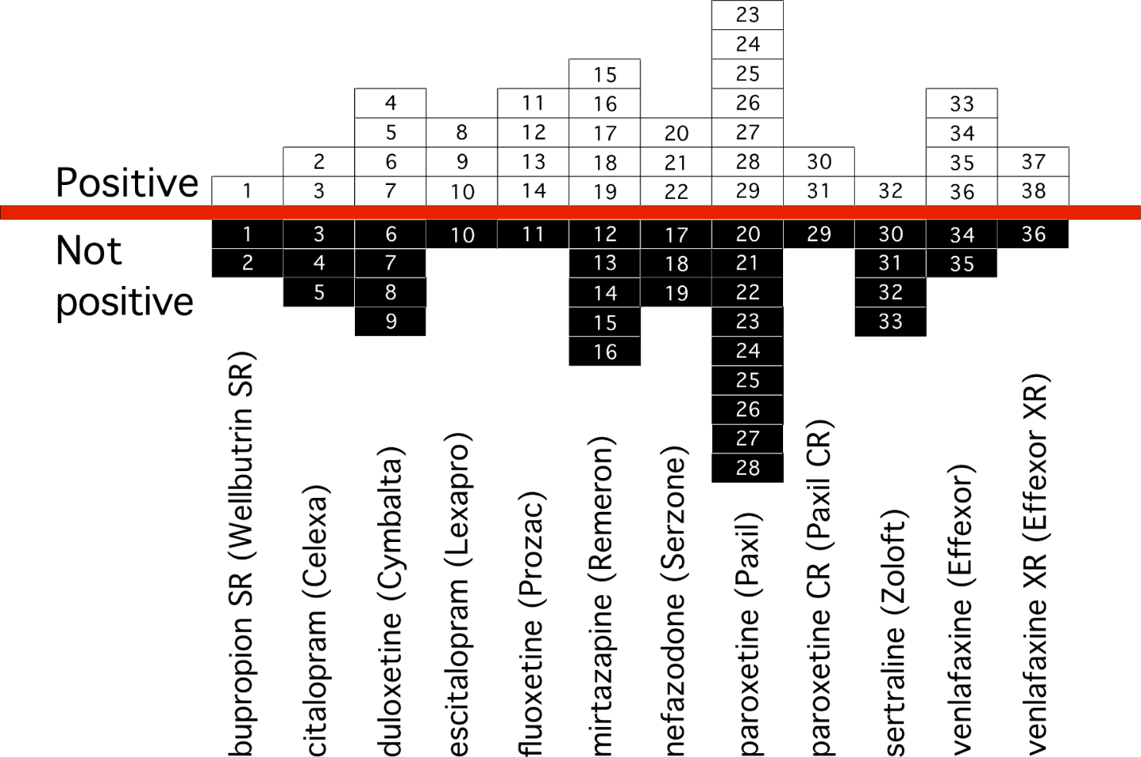
Science relies on the principle that we share our findings
FDA record of clinical trials with 12 antidepressants:
Only positive results published
From Dr Eric Turner: https://figshare.com/articles/Peer_review_After_Results_are_Known_Are_we_PARKing_the_Cart_Before_the_Horse_/3381379

Slide 8

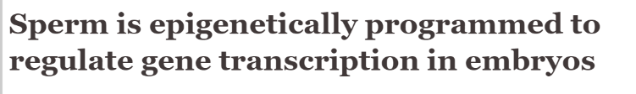
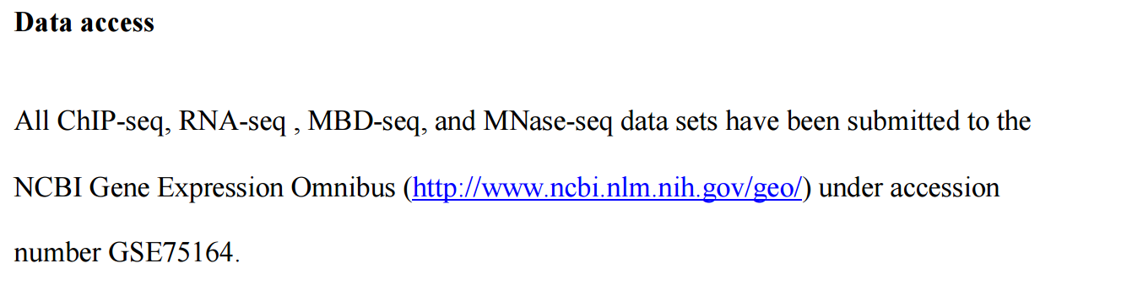
Selfish reason: share once and don’t be bothered
or
http://dx.doi.org/10.1101/gr.201541.115

Slide 9
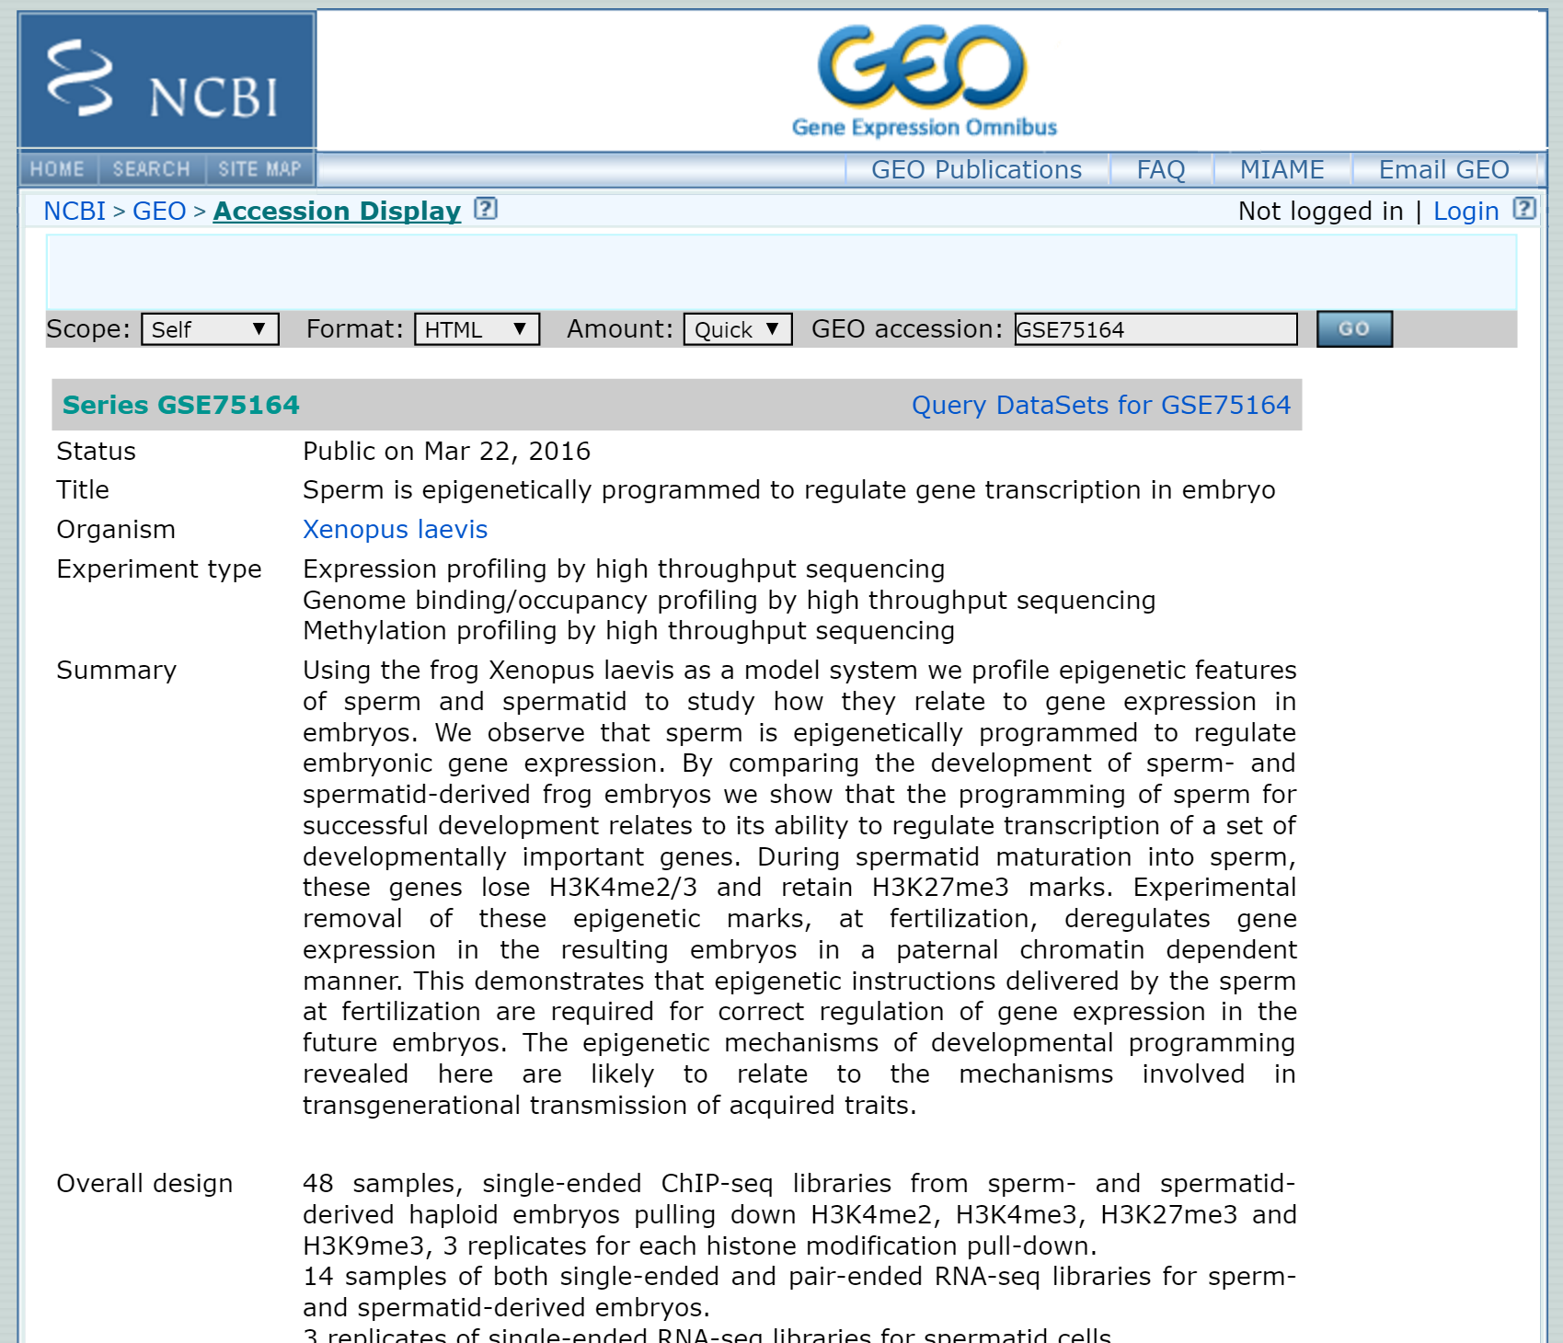
Selfish reason: share once and don’t be bothered
http://www.ncbi.nlm.nih.gov/geo/query/acc.cgi?acc=GSE75164

Slide 10
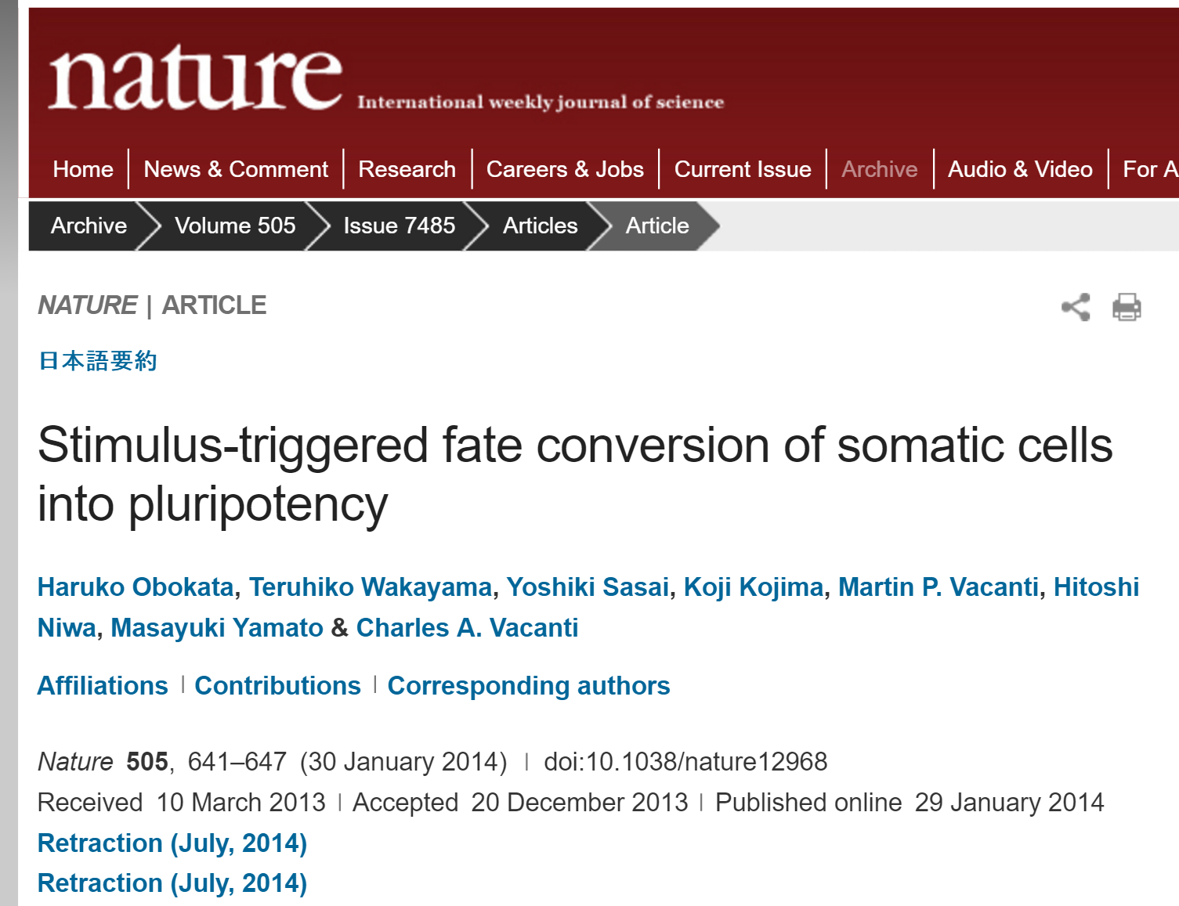

Protection against misconduct
http://dx.doi.org/10.1038/nature12968
http://dx.doi.org/10.1038/nature12969
Notes:
Falsified data

Slide 11
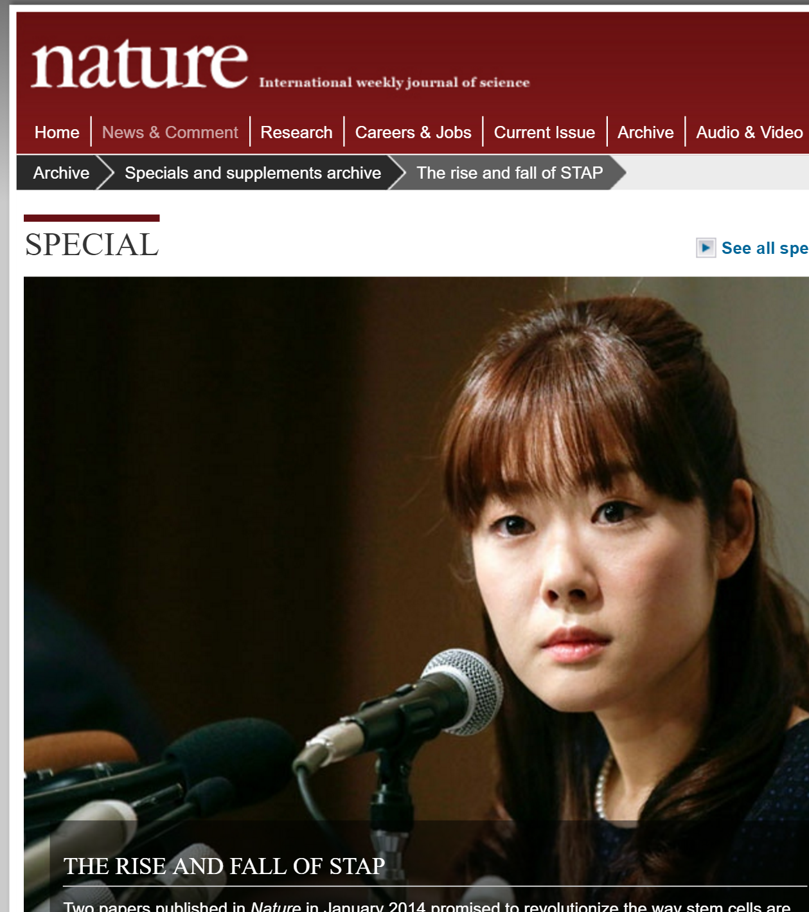

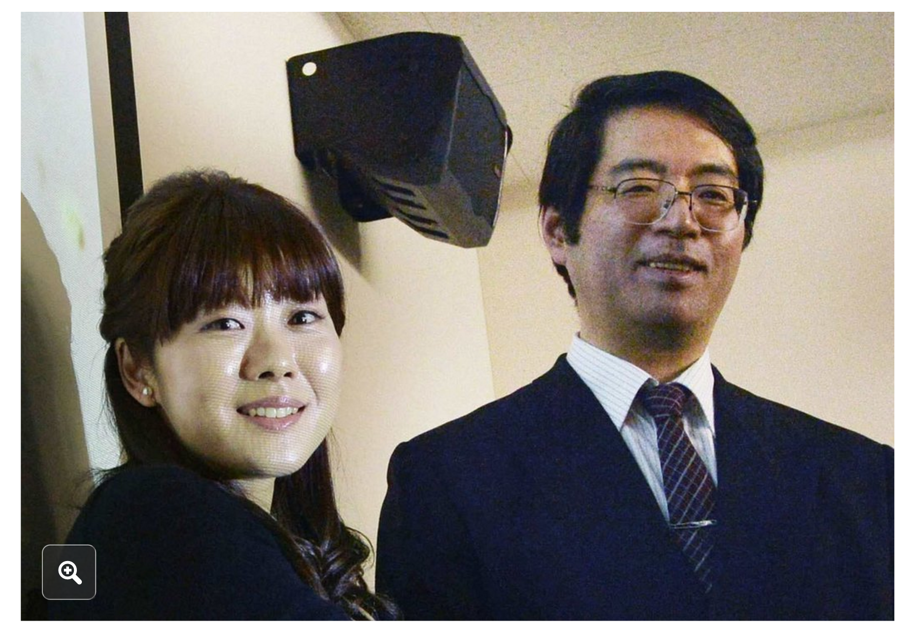
Protection against misconduct

Slide 12





Open Access to publications
Open Access Policies

Slide 13
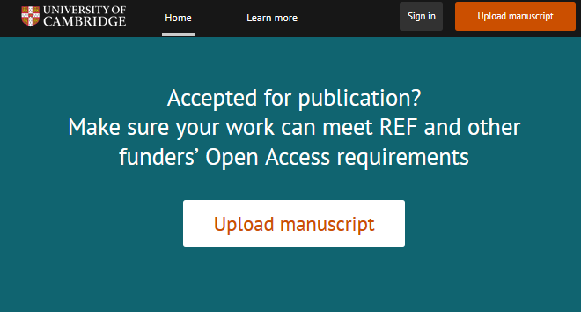
Making your publication Open Access
Send us your paper within 3 months of acceptance, or before signing a copyright form
or choosing an Open Access option – whichever comes first.
www.openaccess.cam.ac.uk

Slide 14






Open Access to research data
“Publicly funded research data are a public good (…), which should be made openly available with as few restrictions as possible…”
www.rcuk.ac.uk/research/datapolicy

Slide 15
Data management plans: compulsory part of grant applications
www.rcuk.ac.uk/research/datapolicy

Slide 16
How to share data?
Store - 10 years+
Describe
Deposit your data in suitable data repositories and add a link to your data in your publication
Exceptions for personal and sensitive data

Slide 17
What is personal data?
“records or other information that, on their own, or linked with other data or information in the possession of the data controller, can reveal the identity of an actual living person”
Data Protection Act (1998)

Slide 18
What is sensitive data?
Personal data + information about:
racial or ethnic origin
political opinions
religious beliefs / other beliefs
trade union membership
physical or mental health or condition
sexual life
Offences/court proceedings…

Slide 19
How to handle personal data?
Don’t collect it!
Gain informed, preferably open and written, consent
Anonymise data
Remove identifiers
Aggregate results
Generalise a variable
Remove outliers
Use managed access repositories

Slide 20
Resources for working with personal/sensitive data
Clinical School website:
Carolyn Read
University Ethics website
Dr Rhys Morgan
Information Management team at UIS
Our website (University resources)
MRC guidelines
ESRC guidelines
Consent forms
Anonymisation guide
Access control
Notes:
Collapse into 1 slide

Slide 21
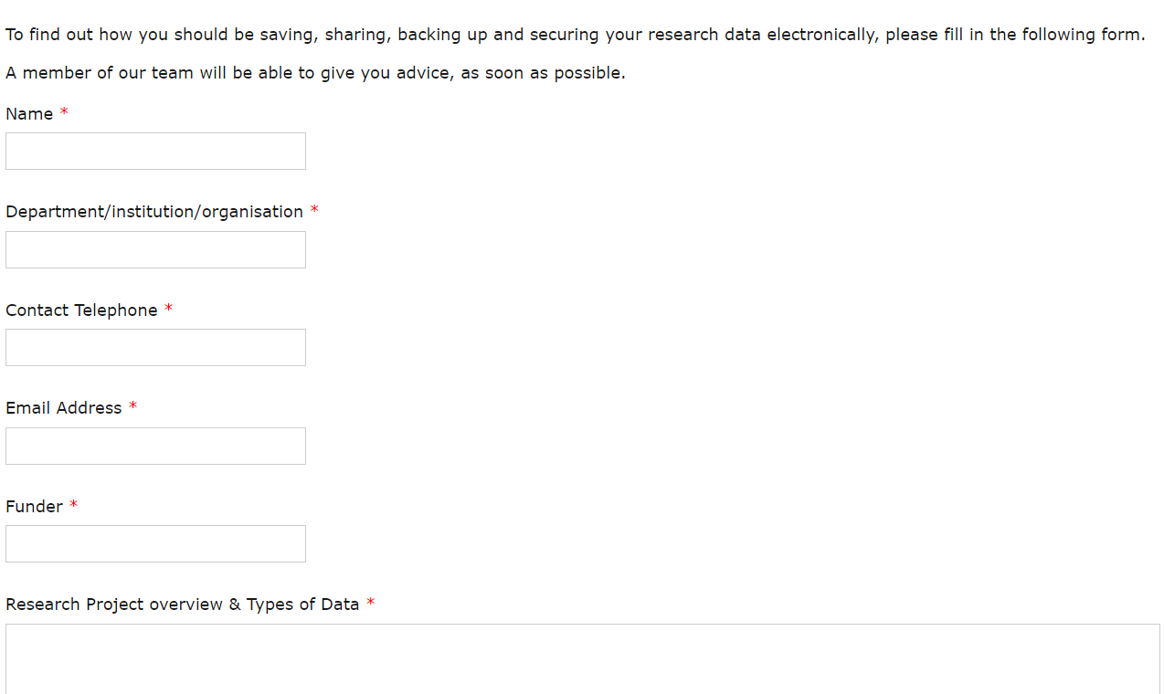
Unsure if your strategy for data management is right?
Information Management team support form
Or e-mail:
informationmanagement@uis.cam.ac.uk
http://www.information-management.uis.cam.ac.uk/research-data-compliance

Slide 22

Cambridge support for data management and sharing
Notes:
Before: Slido polls on awareness of support services: which of these does the University of Cambridge provide?

Slide 23
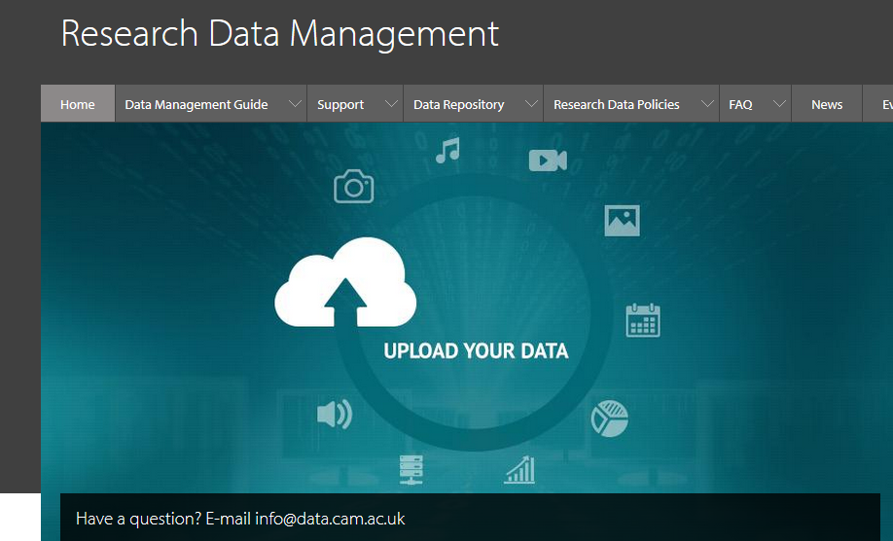
www.data.cam.ac.uk

Slide 24
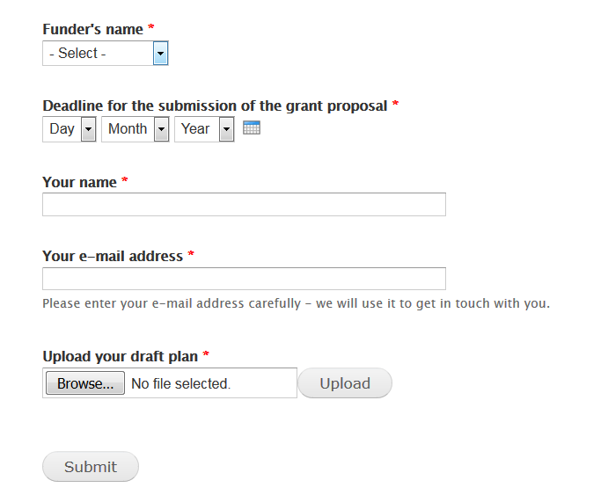
Data management plan support service
+ guidance
+ example plans
www.data.cam.ac.uk/DMPsupport

Slide 25
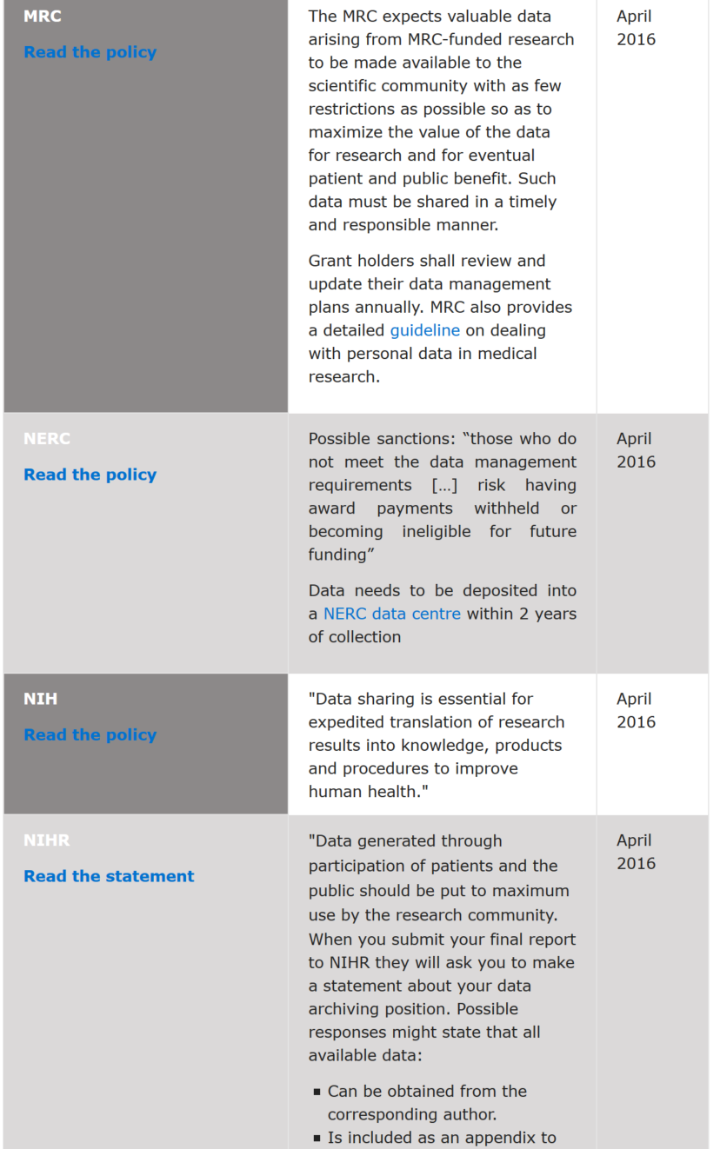
www.data.cam.ac.uk/funders
Funder names arranged alphabetically. Click on the hyperlink to see the full-length policy.
Key policy highlights
Date the policy was last checked or updated.

Slide 26
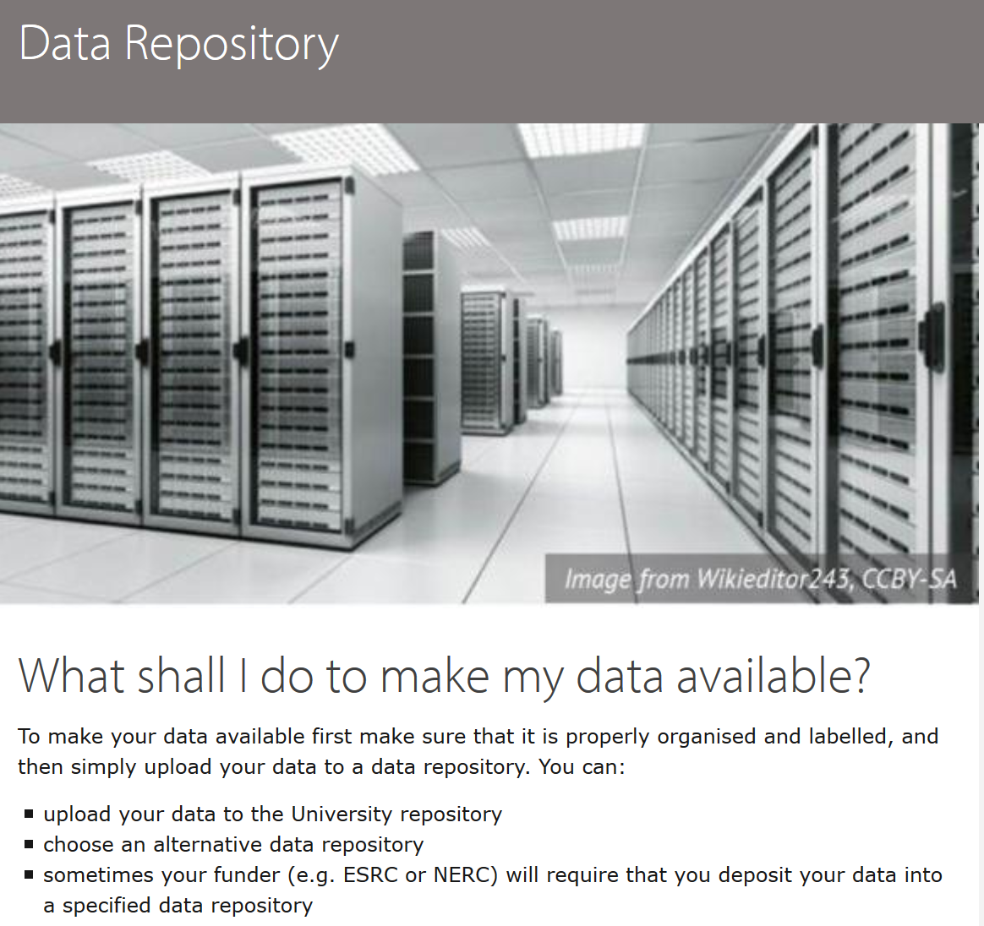
How to share research data?
www.data.cam.ac.uk/repository

Slide 27







Repositories for datasets
http://www.re3data.org/
General purpose
Discipline-specific
Notes:
Sensitive data repositories

Slide 28



Repositories for software

Slide 29
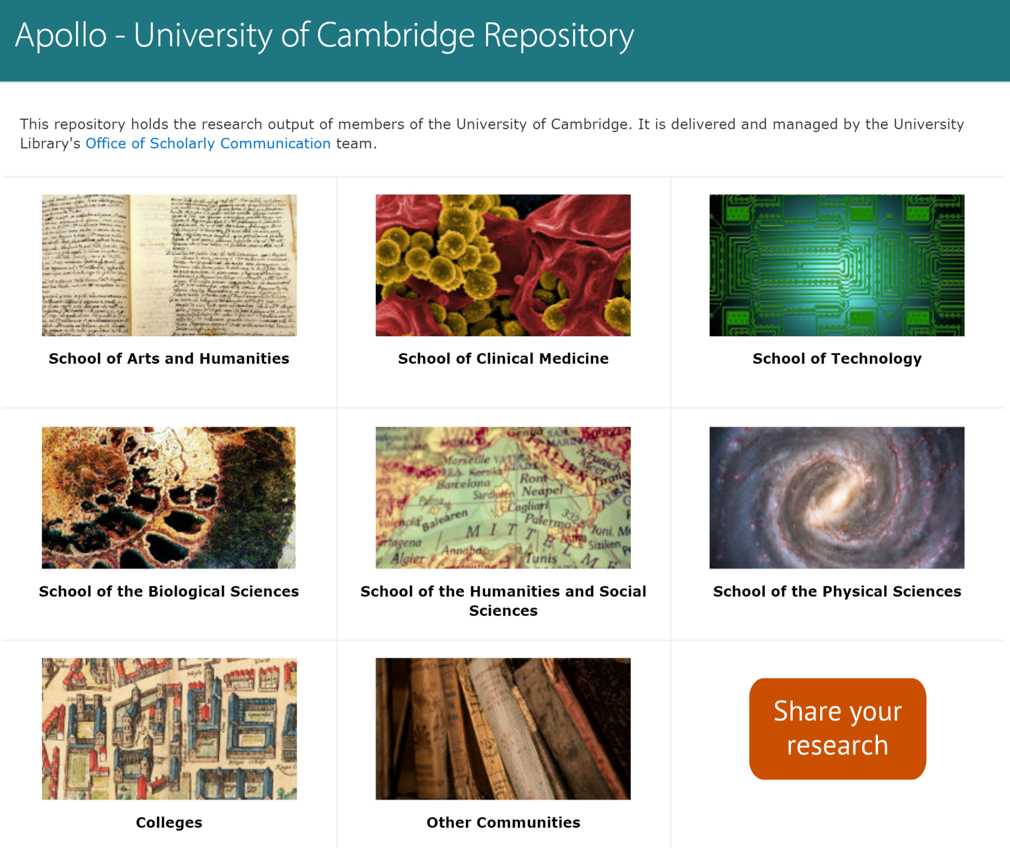
Cambridge research repository
https://www.repository.cam.ac.uk/

Slide 30
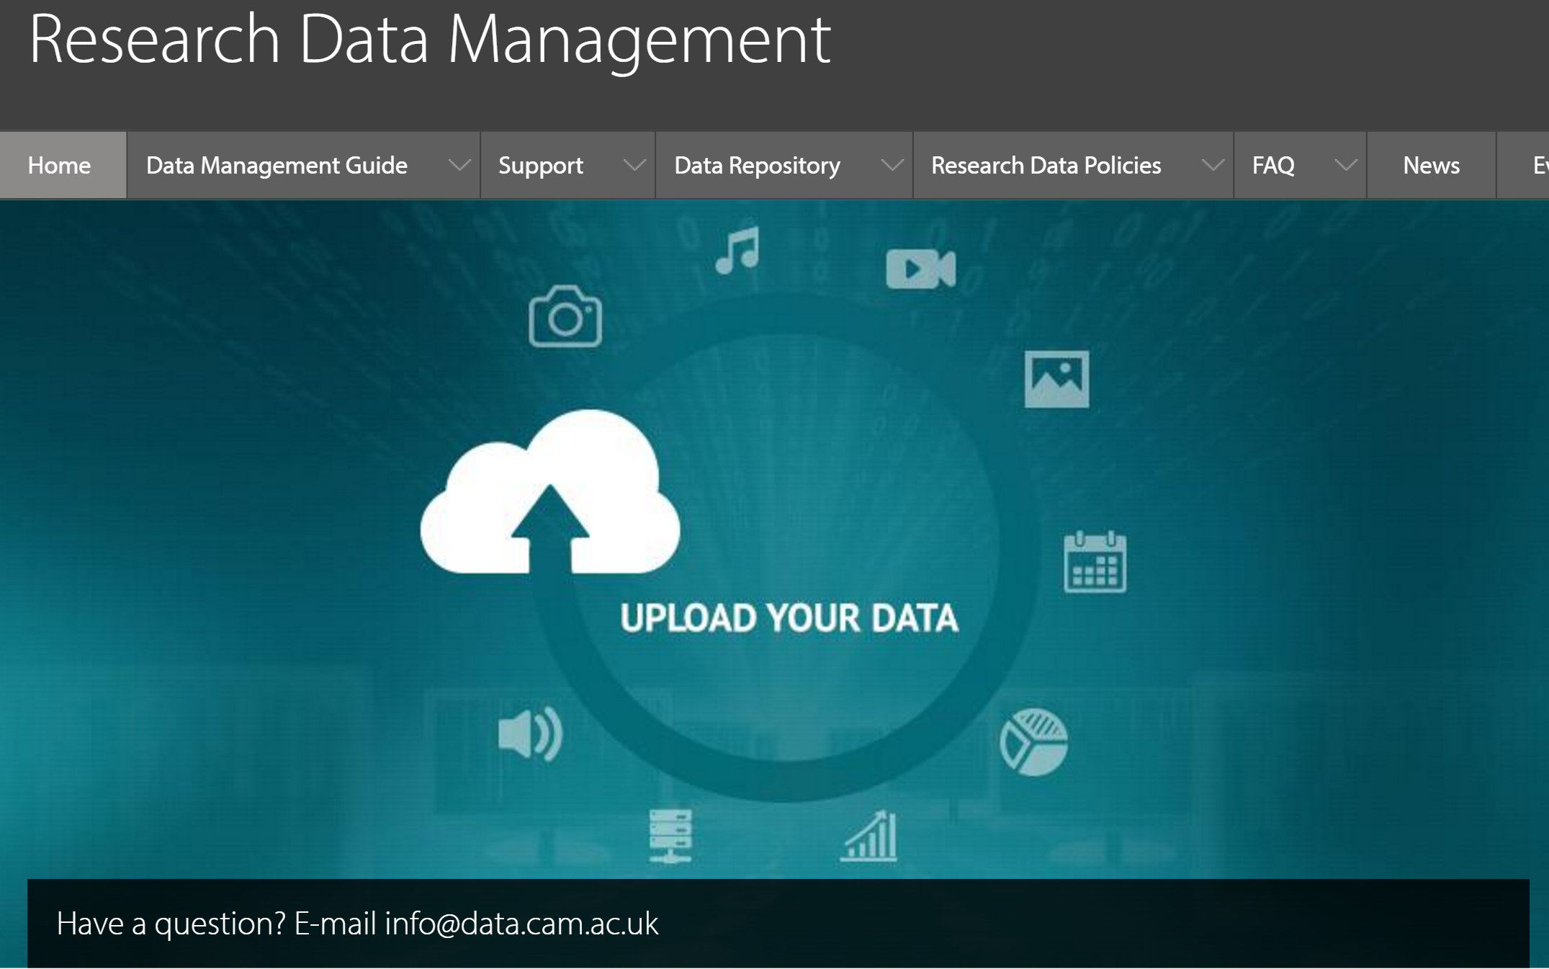
Cambridge data repository
www.data.cam.ac.uk
We will check the data, upload it into the repository and send a link to it

Slide 31
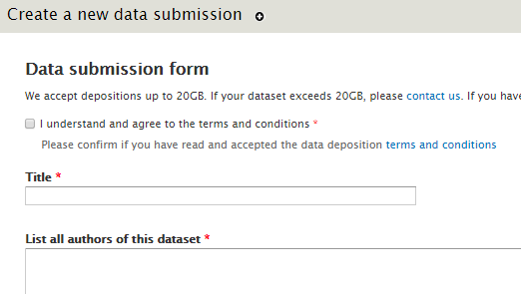
Submit
www.data.cam.ac.uk/upload
Notes:
Separate slide on metadata only records

Slide 32




Creative Commons Licenses
Attribution
Must acknowledge the author of the work
No-derivatives
Cannot change/remix the work
Non-commercial
Only the original author can make money
ShareAlike
New creations must be shared under the same rules

Slide 33
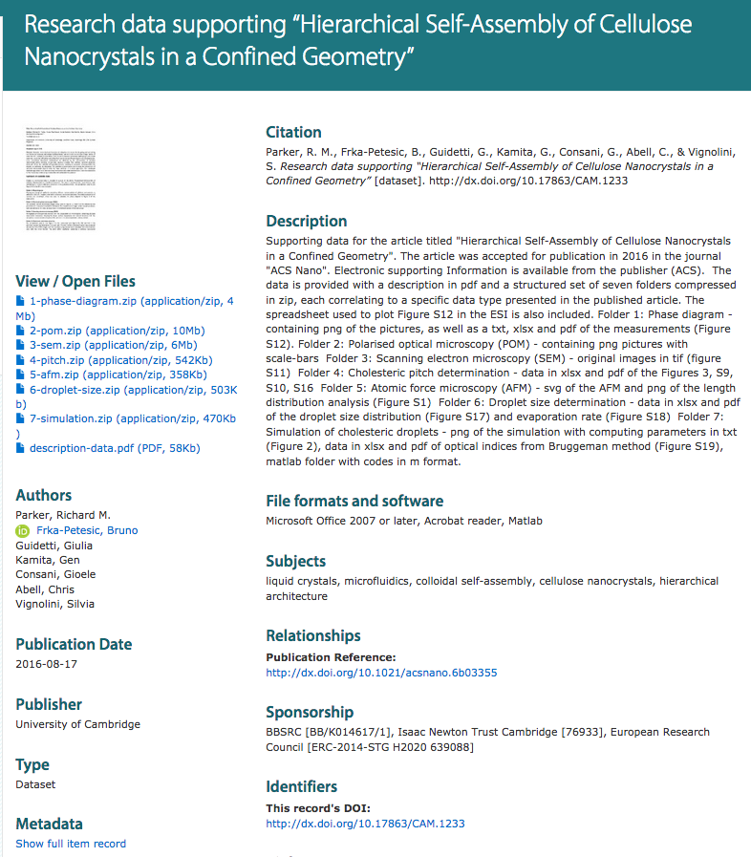
www.repository.cam.ac.uk
http://dx.doi.org/10.17863/CAM.1233
Notes:
REPLACE with better eg

Slide 34
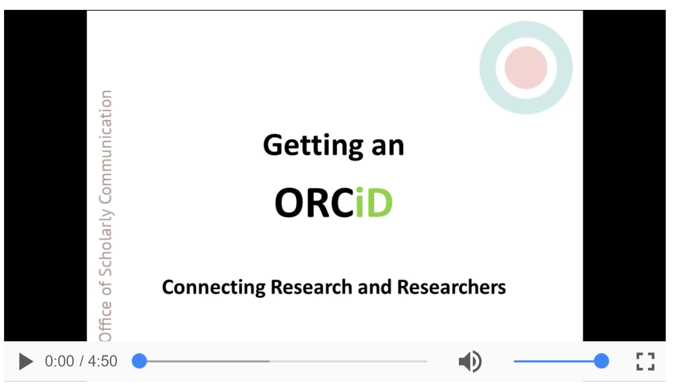
http://osc.cam.ac.uk/author-tools/managing-your-online-presence/getting-orcid
ORCiD: Open Researcher and Contributor ID
What if your name is John Smith?
What if you change your name?
What if you move institutions?

Slide 35
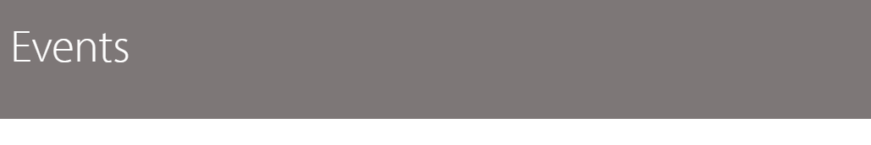
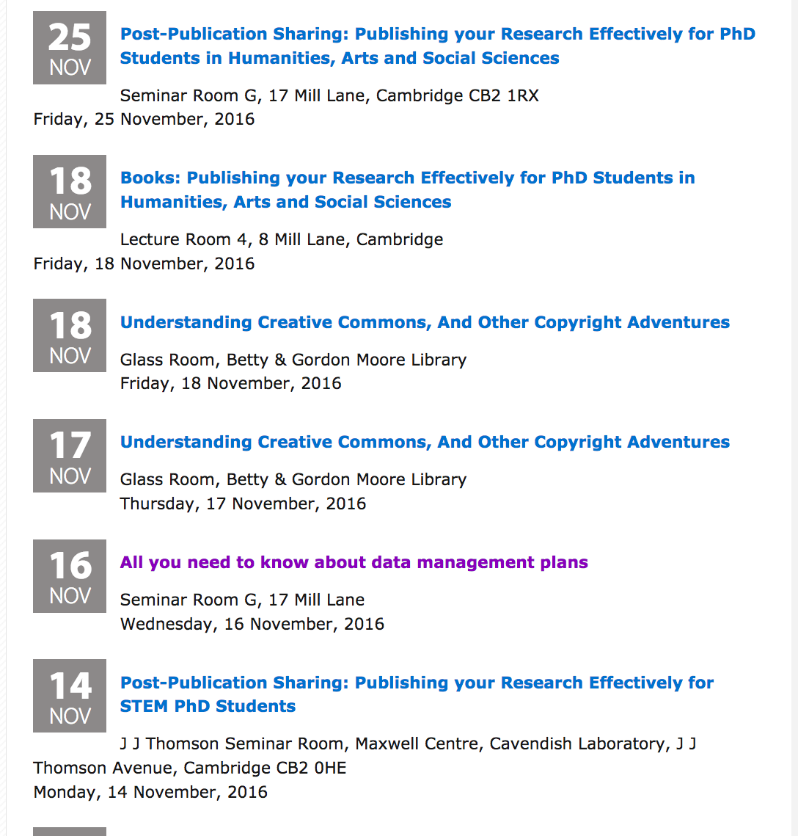
Training and support
www.data.cam.ac.uk/events
Notes:
Update

Slide 36
Next steps
Share data supporting your publication and reference it in the article
When applying for grants
Leave enough time for your Data Management Plan
Budget for staff for data management and long-term preservation
Highlight any data you’ve already shared
Use the support available

Slide 37
Take-home message:
www.data.cam.ac.uk
info@data.cam.ac.uk

Slide 38

Thank you
Enquiries about research data: info@data.cam.ac.uk
www.data.cam.ac.uk
@CamOpenData

